Slide 1
Confidence and
Competence
UNDERSTANDING THE BASICS OF SCIENCE AND ENGINEERING PRACTICES AND HOW YOU CAN USE UTILIZE THEM IN YOUR LESSONS!
KATY ISD SCIENCE
ELIZABETH MORRIS
KELLY SCHUMANN

Slide 2
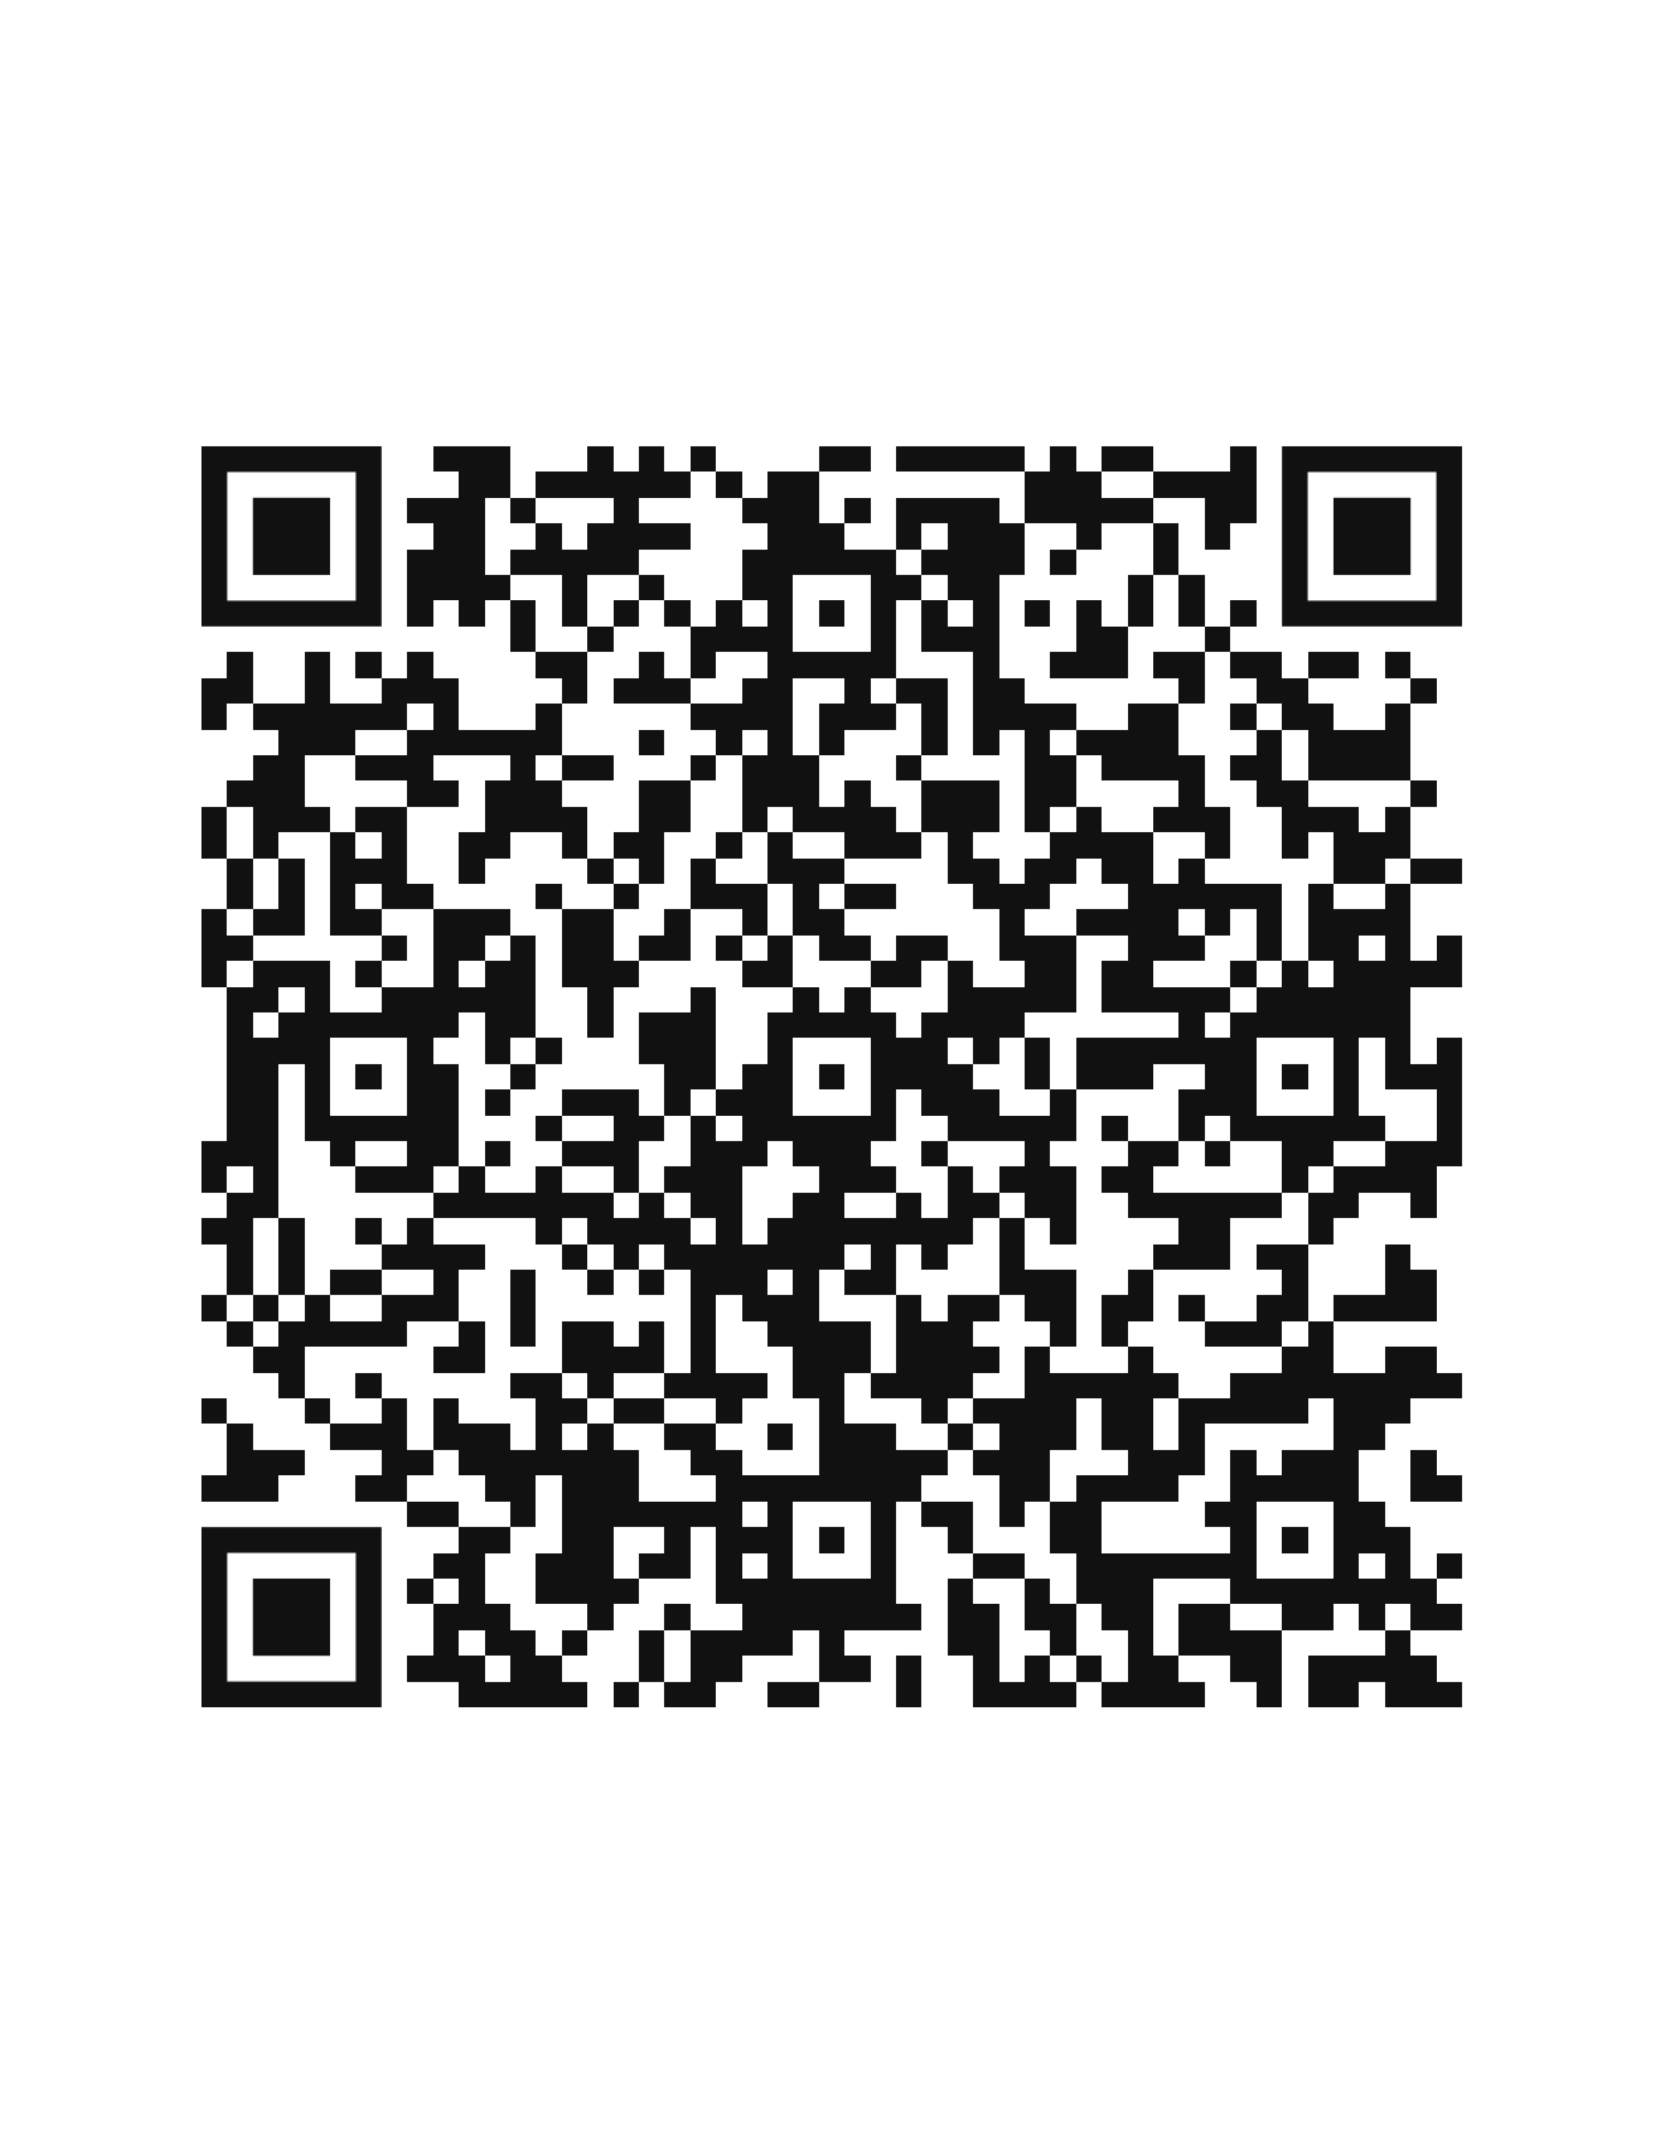
MATERIALS

Slide 3
LEARNING GOALS
EXPERIENCE
PHENOMENA
Experience a mini-lesson that explores and utilizes both phenomena and modeling.
Understand what a phenomena is and how it can be used to leverage student ideas and engagement.
MODELING
APPLICATION
Understand what a scientific
model is and how to implement
them in the classroom.
Apply ideas learned to upcoming events.

Slide 4
PHENOMENA

Slide 5
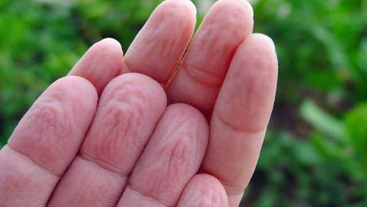

Slide 6
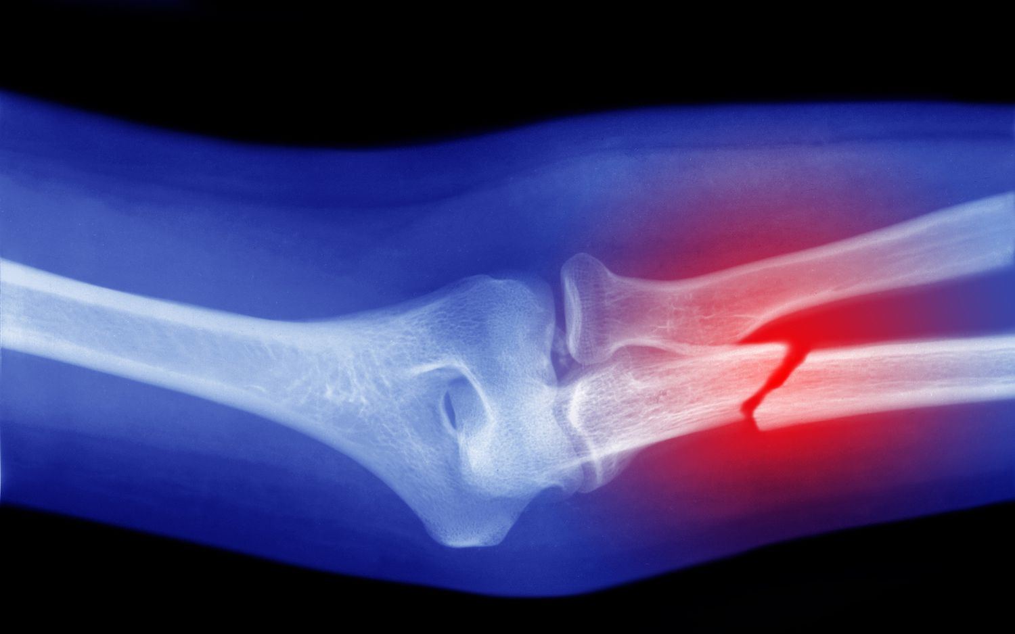

Slide 7
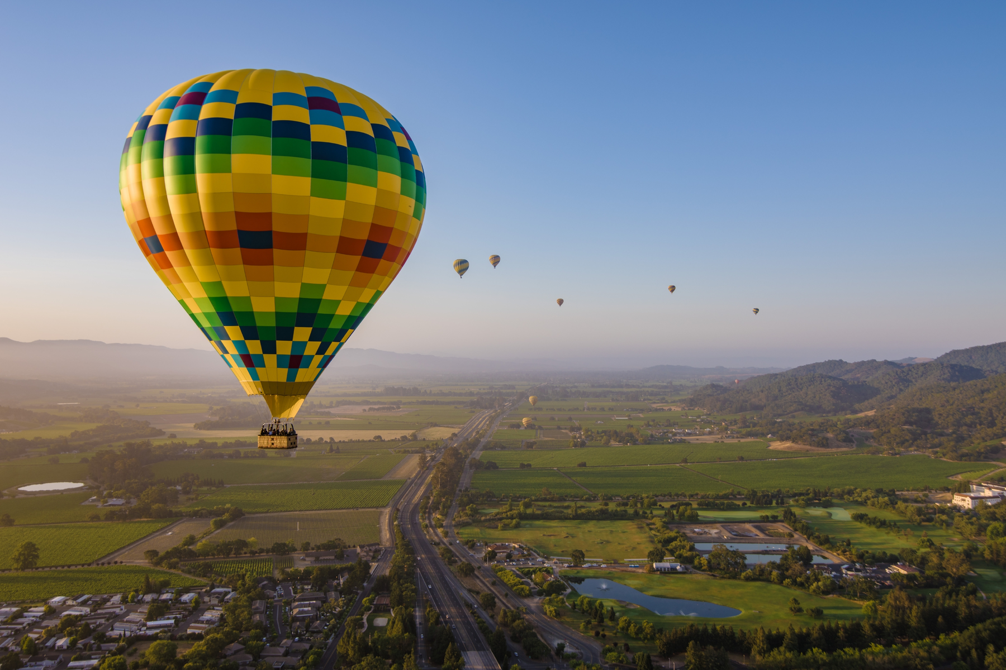

Slide 8
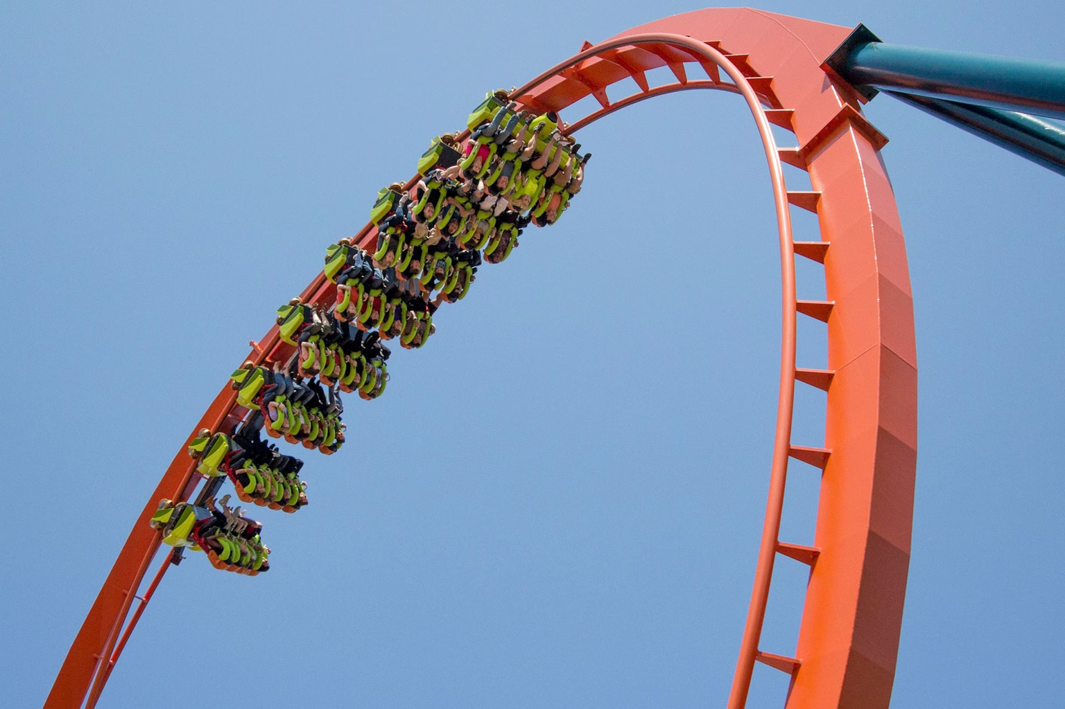

Slide 9
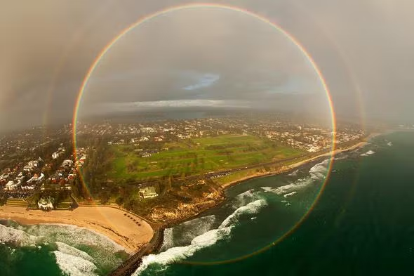

Slide 10
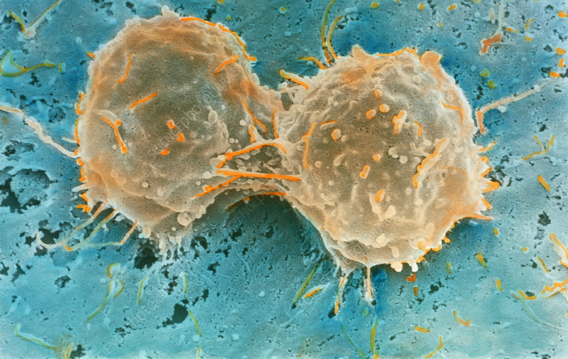

Slide 11
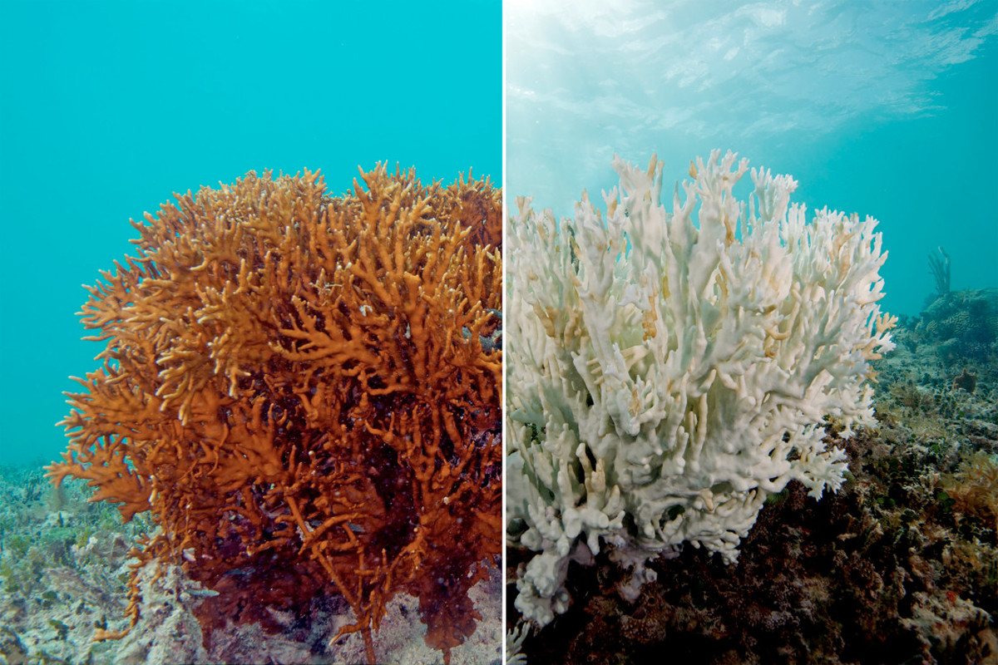

Slide 12




NOTICE AND WONDERINGS
ALONE ZONE
In the alone zone, on your handout, write what you notice and wonder about the phenomena.
TABLEMATES
Share your notice and wonderings about phenomena with those at your table. Consolidate your ideas. When sharing, use the sentence stems "What I noticed about the phenomena..." and "What I wonder about the phenomena..."
SHARE OUT
The tablemate that has been teaching the longest, share your group's notice and wonderings. Use the sentence stems "We noticed that the phenomena..." and "What we wonder about phenomena is..."

Slide 13
WHAT IS A PHENOMENA?
An observable, naturally occurring event found anywhere in the world that scientific knowledge can be used to explain or predict.

Slide 14
WHY DO WE USE PHENOMENA?
CONTEXT
MOTIVATION
EMPOWERING
Using phenomena in the classroom gives context and purpose to science learning as students "do something" with science and become agents of their own learning.
By centering science education on phenomena that students are motivated to explain, the focus of learning shifts from learning about a topic to figuring out why or how something happens.
The use of phenomena enables students to ask and investigate questions and then use evidence they gathered to explain the event.

Slide 15
HOW TO SELECT PHENOMENA
STUDENT GROWTH
ACCESSIBILITY
RELEVANCY
Can students observe or investigate the phenomena either through firsthand experiences (in the classroom) or through someone else's experience (videos, news, presentations)?
By making sense of the phenomena, are students building understanding toward grade level expectations?
Is the phenomenon relevant to real-world issues or students' local environment? Does it align with the Science Standards?

Slide 16
PHENOMENA EXAMPLES

Slide 17
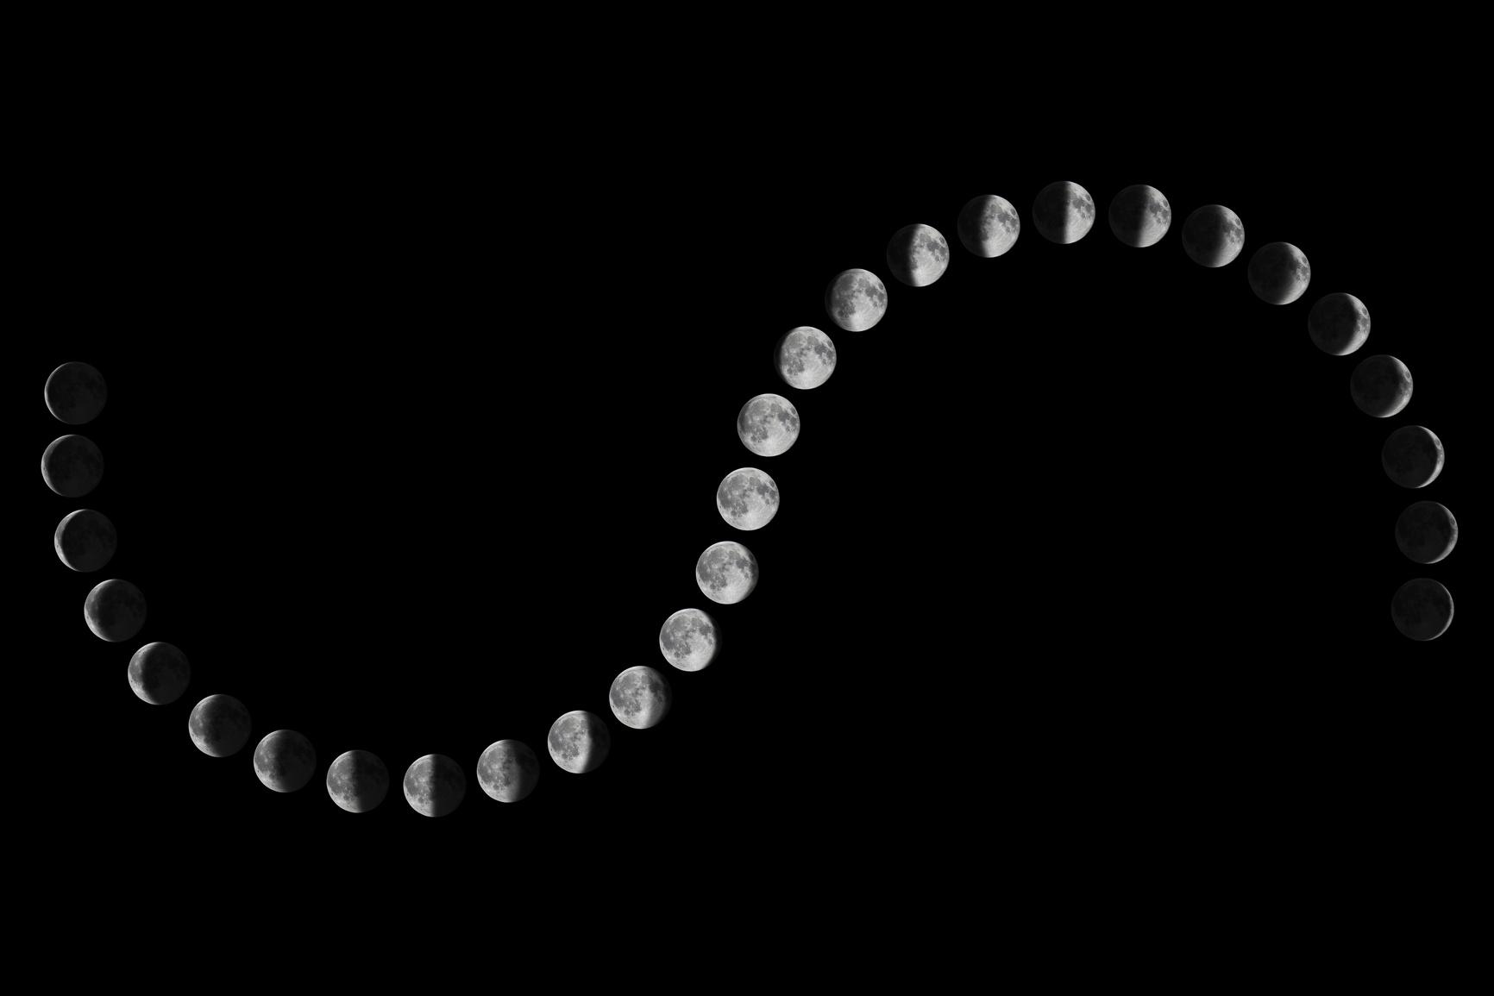
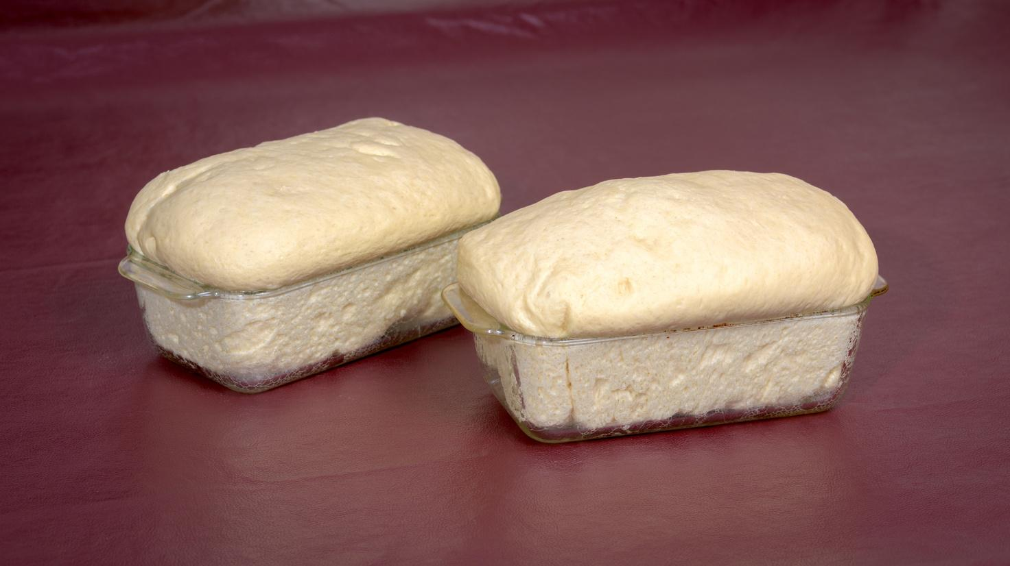
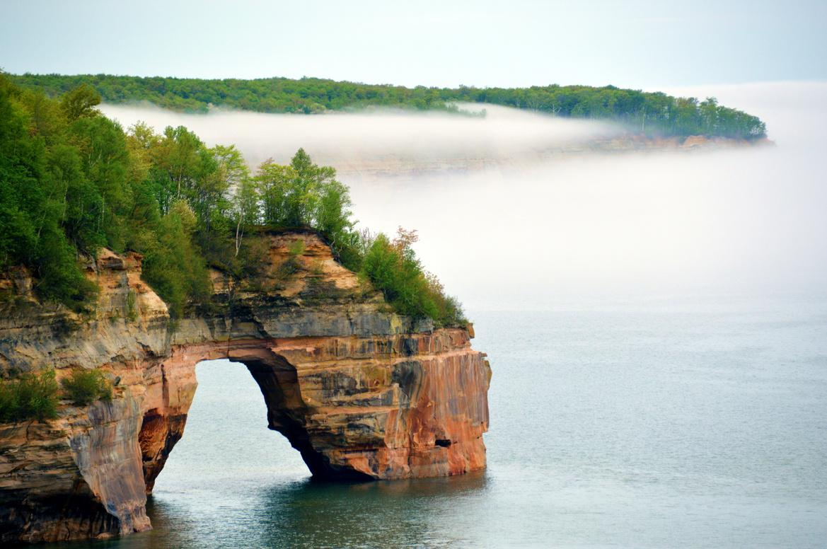
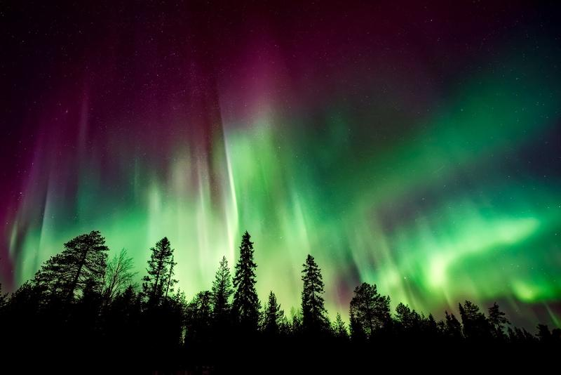
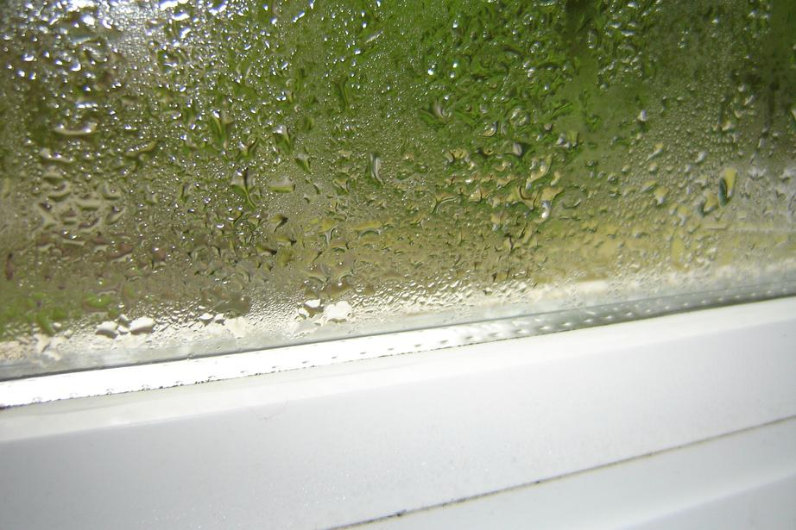
  Moon phases
  Dough rising
  Arch formation
  The Northern Lights
  Condensation forming on a window

Slide 18
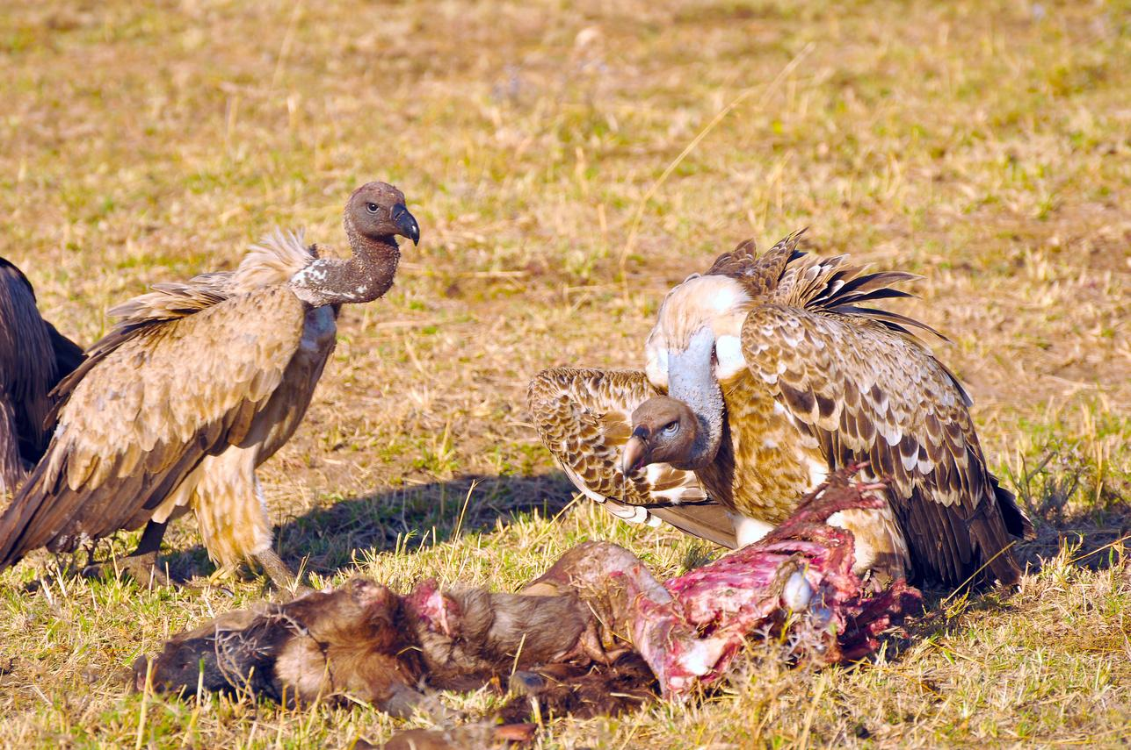
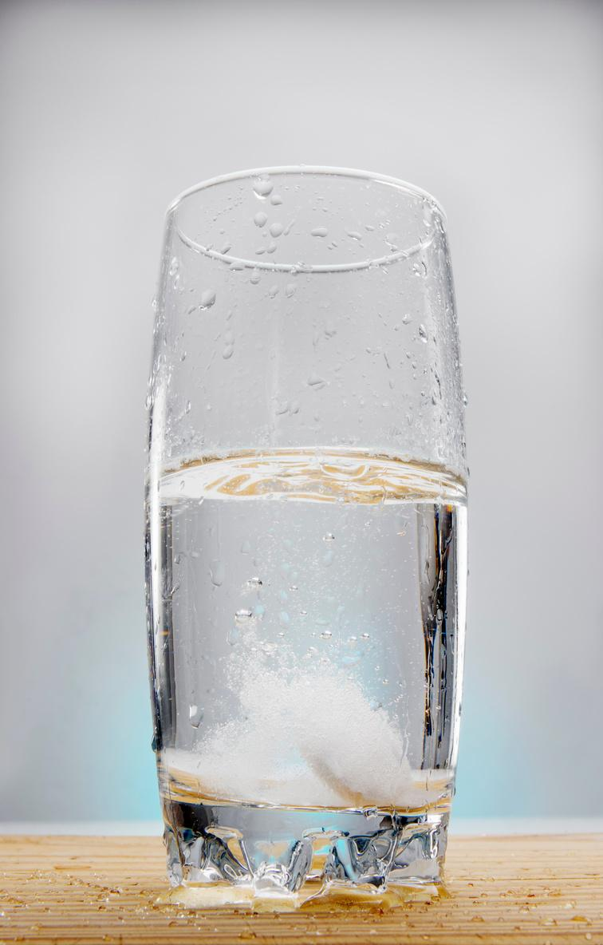
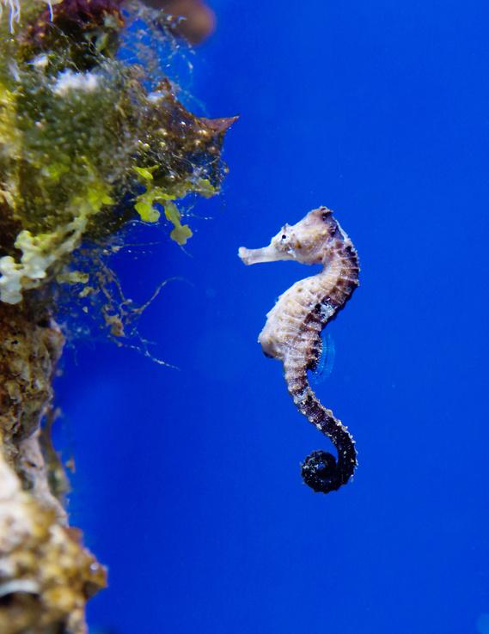
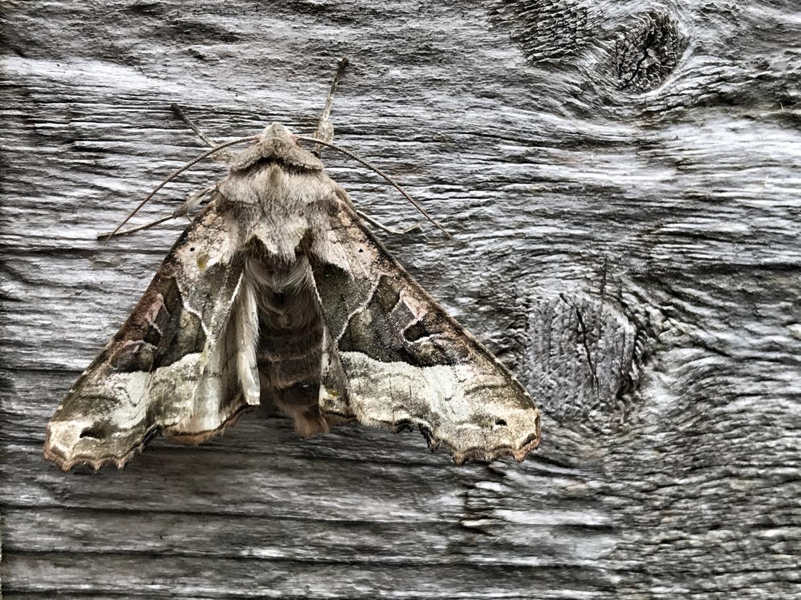
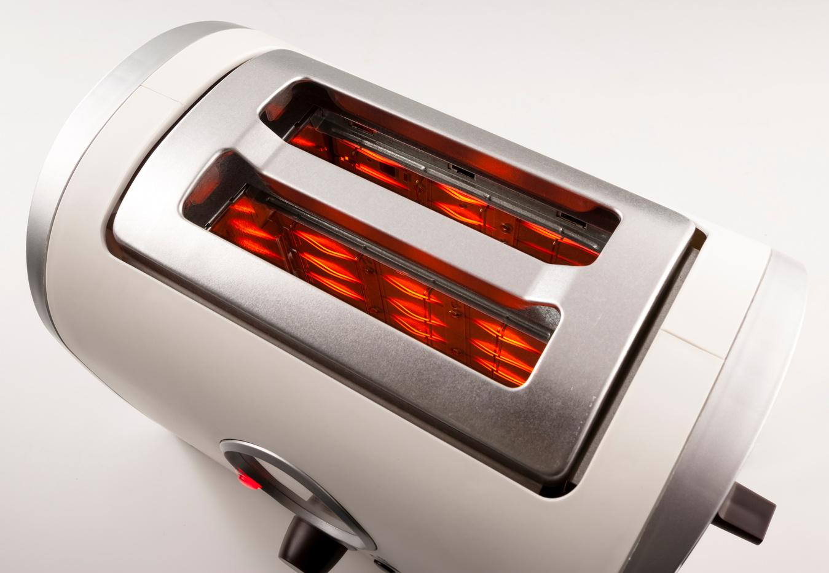

  Vultures eating decaying matter
  Seltzer tablets fizzing
  Male seahorses carrying offspring
  Camouflaged moth
  Toaster coils turning red
  The color of fireworks

Slide 19
CREATING MODELS WITH PHEMONENON

Slide 20
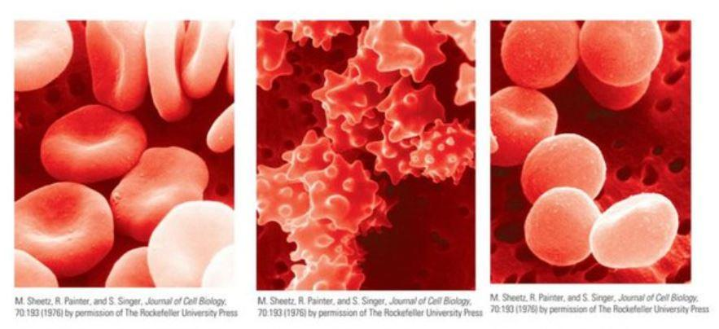
REMINDER: A GOOD PHENOMENON DOESN’T HAVE TO BE PHENOMENAL

Slide 21
GUIDING QUESTION
How does the concentration of a solute in a solution determine the movement of water across a membrane?

Slide 22
CREATING A MODEL
Using the supplies provided, create a model that answers the guiding question.
How does the concentration of a solute in a solution determine the movement of water across a membrane?

Slide 23
GALLERY WALK
Notes:
If you used playdough, now would be a great time to take a picture.

Slide 24



DISCUSSION
NOTICE
What did you notice about the models from other groups?
CHANGES
Is there anything that you and your group would like to add to your models? Why?
RESOURCES
Is there anything that would have helped you and your group when creating your model?

Slide 25
EVIDENCE
Use the evidence that has been provided to you to complete your summary table.
Notes:
This is what you most likely are already doing in your classrooms over the course of the unit.
** need summary table to show as an example

Slide 26
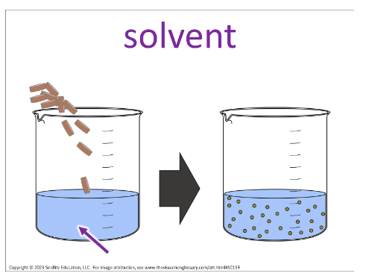
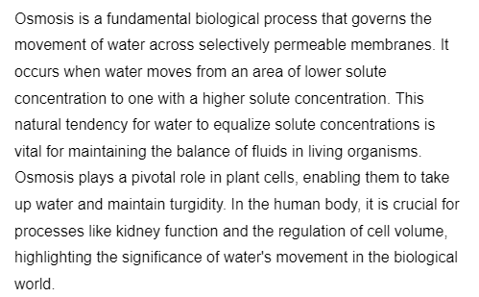
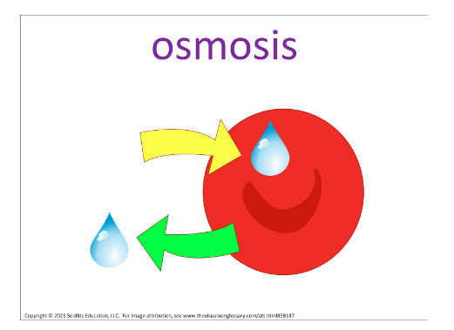
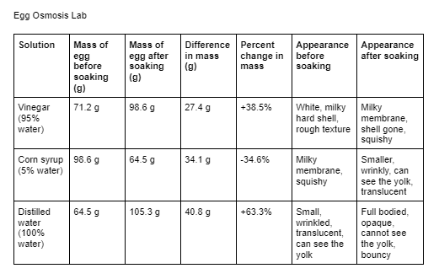
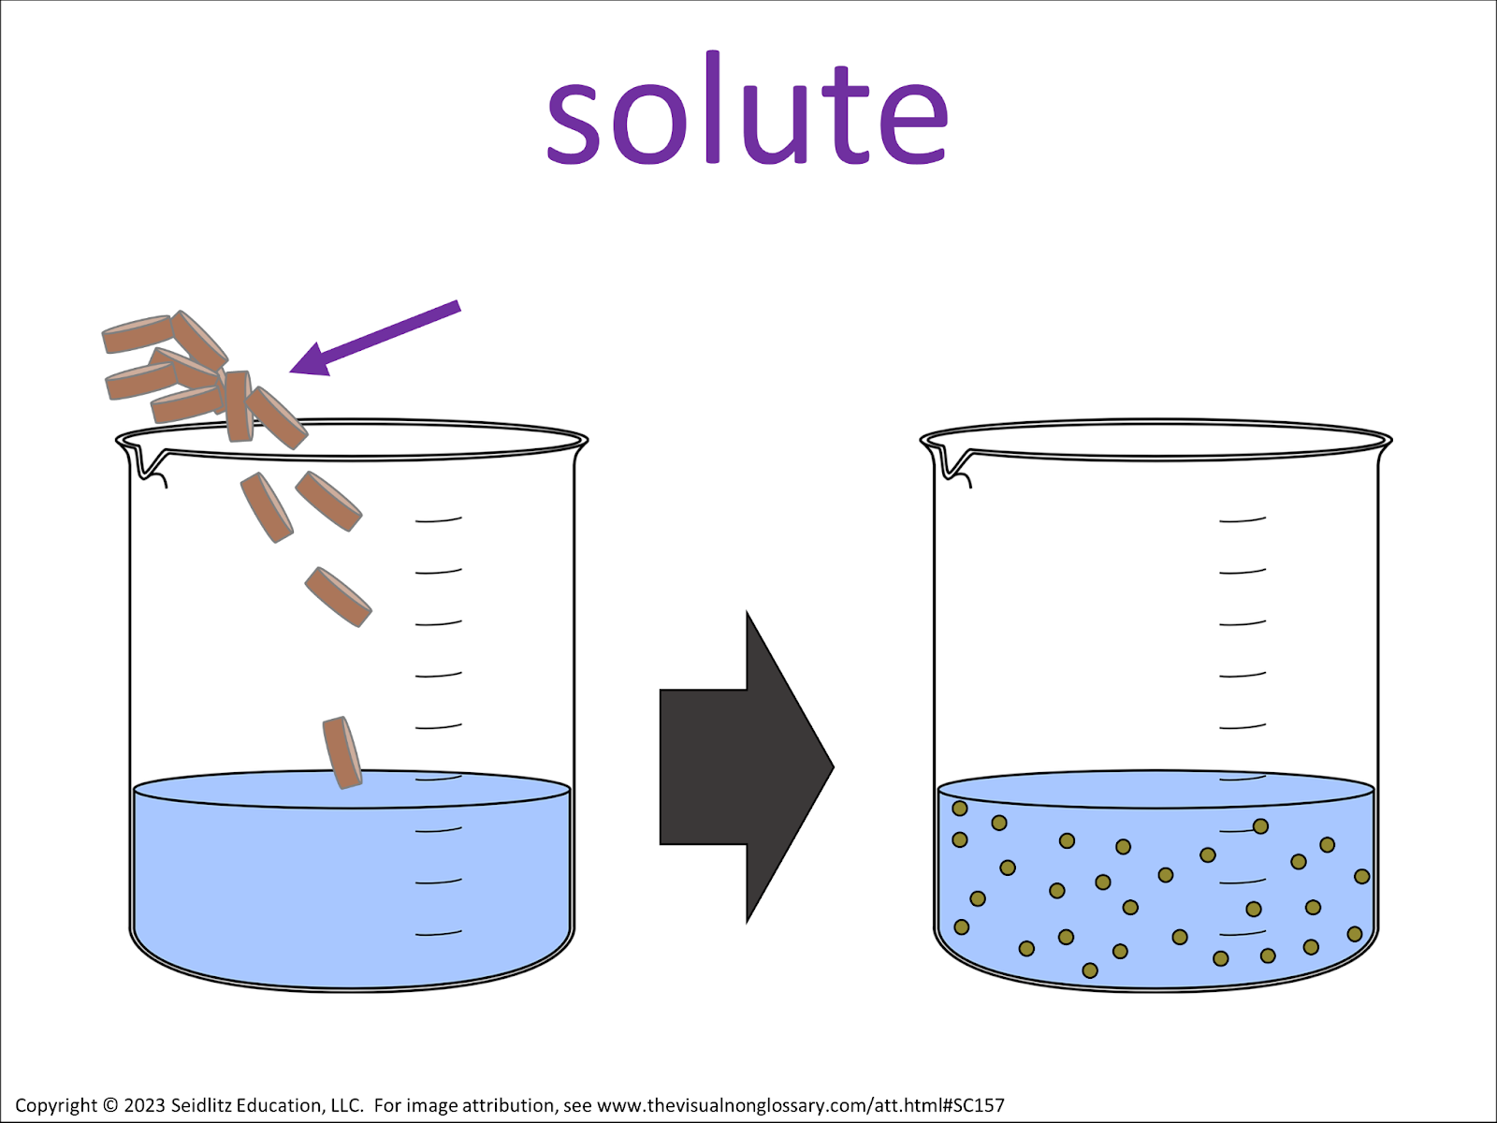
Notes:
This is what you most likely are already doing in your classrooms over the course of the unit.
** need summary table to show as an example

Slide 27
REVISIONS
With the help of your summary table, create a final model.

Slide 28
How has your final model changed from your initial model?

Slide 29

SCIENTIFIC MODELING
“THE BEST IDEA IN YOUR HEAD PRESENTED OUTSIDE YOUR HEAD FOR OTHERS TO SEE.”
-Paul Anderson

Slide 30
PURPOSE OF MODELING
  Describe, explain, and predicts natural phenomena
  Communicate scientific ideas to others

Slide 31
WHY USE MODELING IN THE CLASSROOM?
  See patterns, identify relationships or mechanisms, construct or communicate explanations, make predictions, and pose new questions for investigations
  Makes students' thinking visible along with the changes to their thinking over time
  Reveals gaps in knowledge
  Helps students develop and make connections among ideas and to solve problems about everyday situations
  Uses evidence to make and critique claims
  Understand the role that models play in scientists' knowledge building (nature of science)
  Increases scientific literacy

Slide 32
SCIENTIFIC MODELING
QUALITIES
MODEL ELEMENTS
  Represents an event or process of a phenomenon that happens in a specific place and time under specific conditions
  Use of visual is key
  Includes both observable and unobservable features
  Can be constructed, tested, evaluated, and revised
  Legend or Key
  Symbols/Arrows
  Comic Strip
  Text Boxes
  Zoom-in/out
  Cross-section
  Mini Graphic Organizer
  Map/Geographic Representation
  Timeline

Slide 33
SCIENTIFIC MODELING
POSSIBLE SCAFFOLDS TO PROVIDE
  Peer review of models using sticky note feedback (add an idea, revise an idea, pose a question)
  Prompting questions with each activity/investigation
  Summary chart to collect data from each activity/investigation
  A model template that can include: the essential question, a base pictorial layout, and explanation elements such as text boxes
  "Gotta-Have" checklist of ideas, etc. for the final model
  Keys to agreed-upon modeling of elements

Slide 34
Which SEPS were INCORPERATED in THIS LESSON?
  Asking questions and defining problems
  Developing and using models
  Planning and carrying out investigations
  Analyze and interpret data
  Using mathematics and computational thinking
  Constructing explanations and designing solutions
  Engaging in argumentation from evidence
  Obtaining, evaluating, and communicating information
Notes:
These could be seen/experienced throughout this anchoring phenomenon (during evidence pieces)

Slide 35
BUT HOW DO I HAVE TIME TO DO THIS TYPE OF LESSON IN MY CLASSROOM?

Slide 36
SAMPLE TIMELINE
Day 1: Initial Model; Reading activity; Set up eggs for osmosis lab
Day 2: Visual Non-Glossary activity; Check and weigh eggs, place in new solution
Day 3: Osmosis Practice WS; Check and weigh eggs, place in new solution
Day 4: Final egg day- data collection, post-lab
Day 5: Final models; assessment

Slide 37
STUDENT
SAMPLES

Slide 38
QUESTIONS?

Slide 39
MATERIALS

Slide 40
THANK YOU!
FOLLOW US ON TWITTER (X)
@ebmorris89
@kelly_schumann

