Slide 1
MRHS Biology
Ecology Modeling Example
Using Model-Based Inquiry (MBI)
Why did whaling lead to a collapse in fish populations and contribute to climate change?

Slide 2
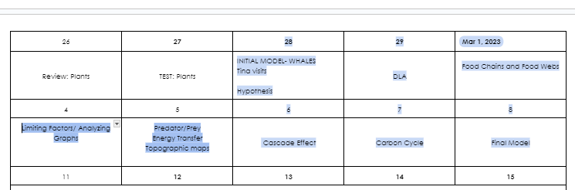
KAP Bio Unit 11

Slide 3
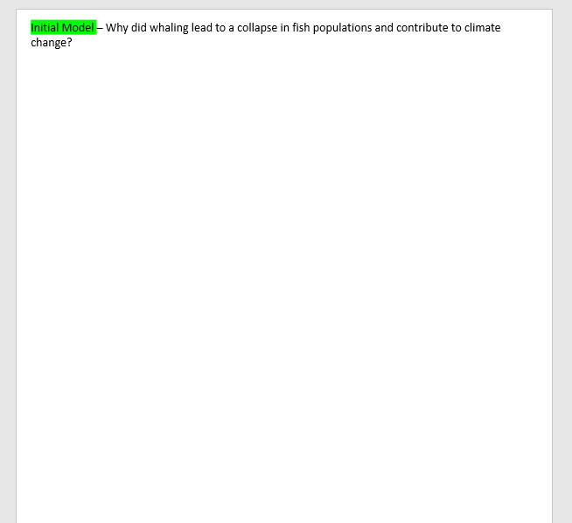
After watching videos and looking at images - teachers told students to draw a model showing that answers the guiding question.

Slide 4
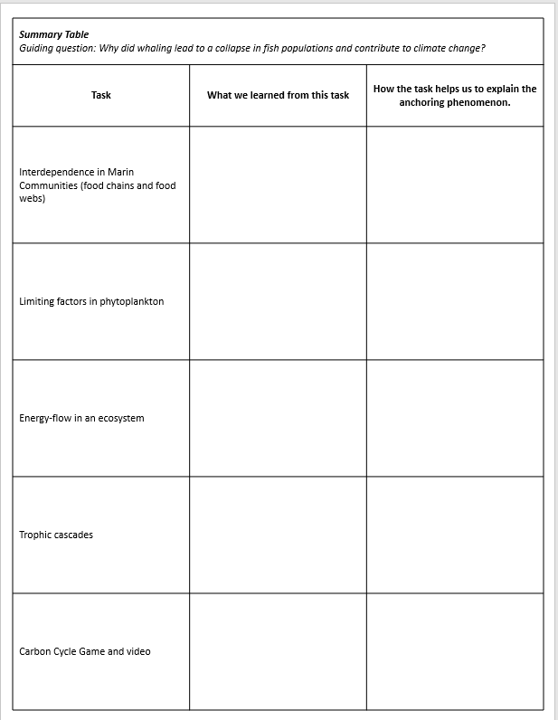
Summary Table
–How students made connections between each unit activity & the phenomenon
–Students used table to help improve their model & understanding of unit
– Facilitated sensemaking
Notes:
More about summary tables– https://ambitiousscienceteaching.org/tools-face-to-face/#Summtable

Slide 5
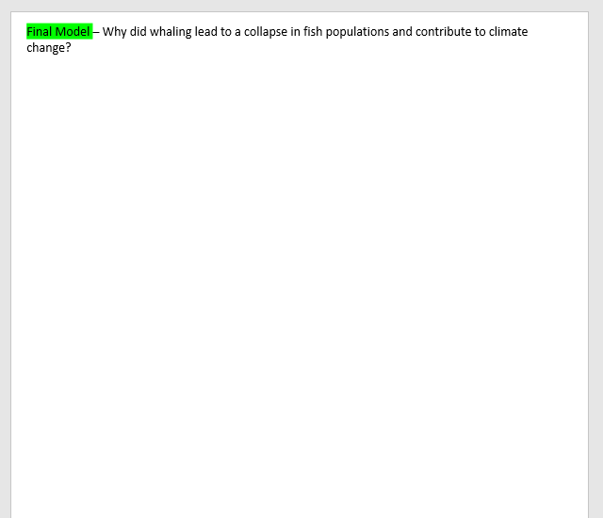
Teachers had students co-create a checklist of what they felt they should include in their final model to show they understood the units’ content

Slide 6
Student Work Samples
Initial vs. Final Models

Slide 7
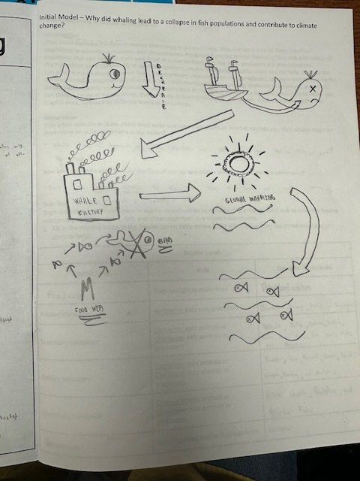
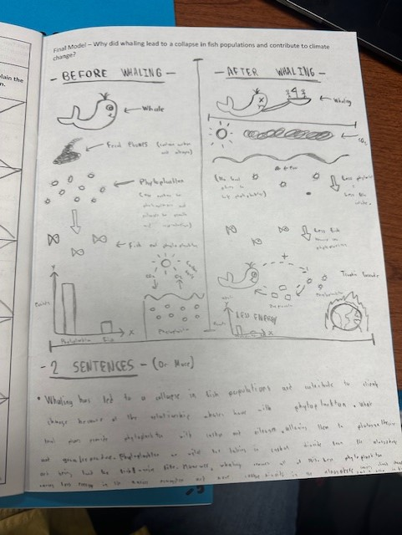
Initial vs. Final Models

Slide 8
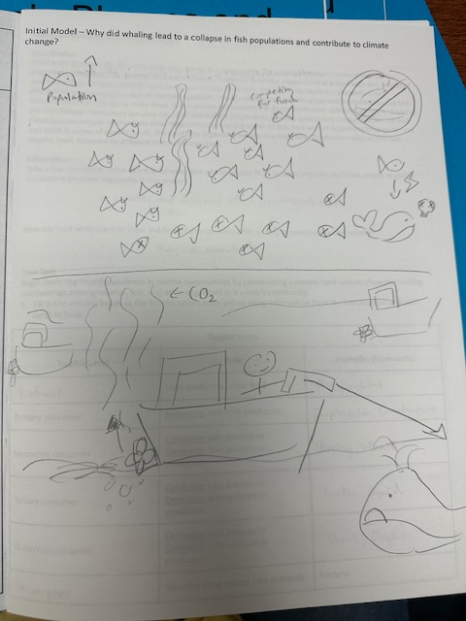
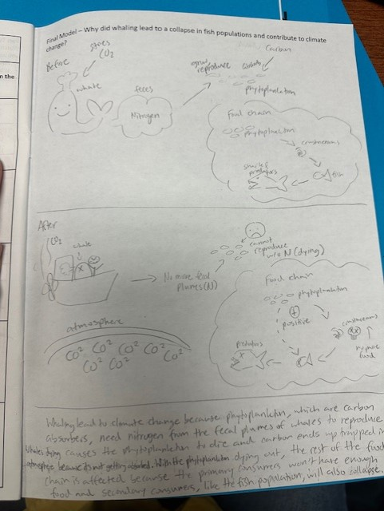
Initial vs. Final Models

Slide 9
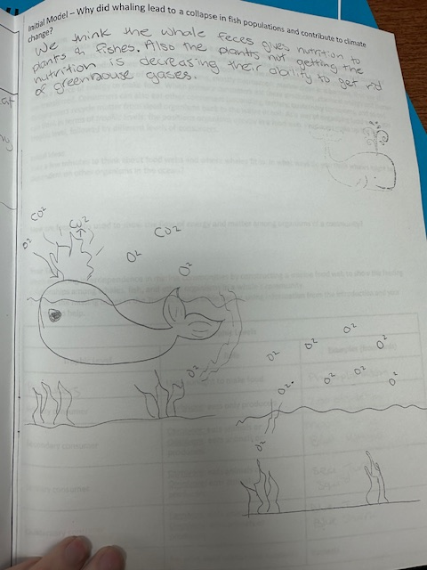
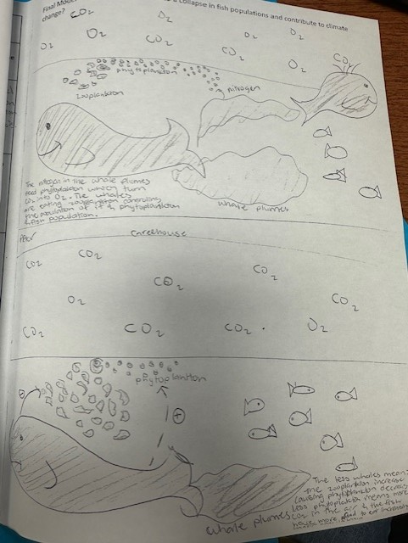
Initial vs. Final Models

Slide 10

THS Biology
Cell Transport Modeling Example
Can you release a goldfish into Galveston?

Slide 11
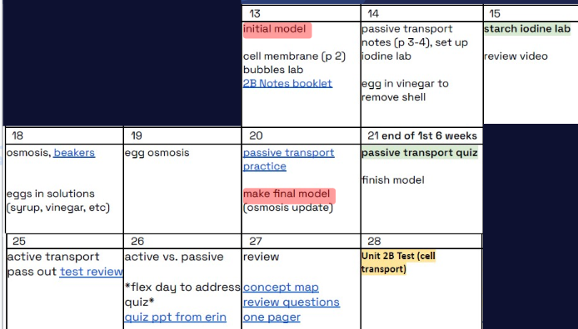
Aca Bio Unit 2

Slide 12
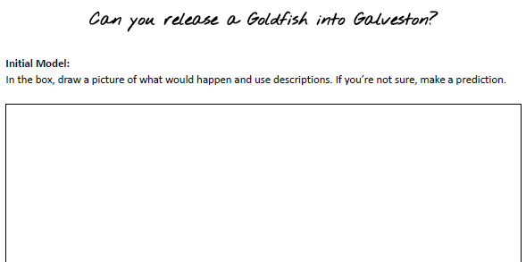
After posing the guiding question - teachers told students to draw a model showing what would happen to the goldfish if it was released into Galveston

Slide 13
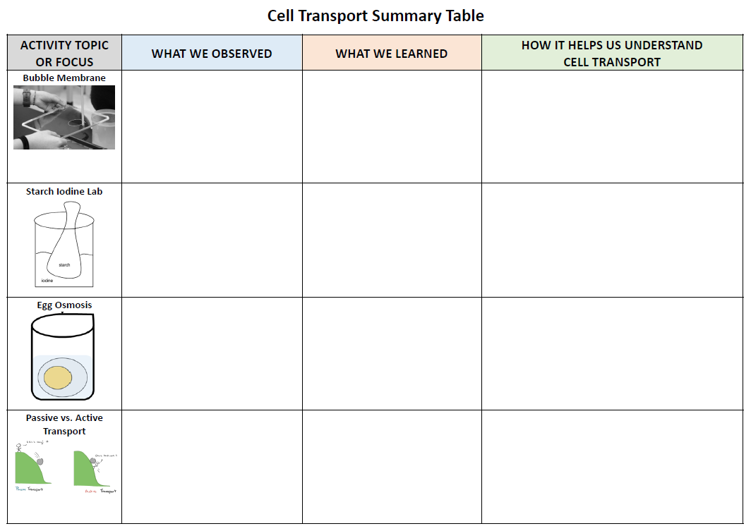
Summary Table
–How students made connections between each unit activity & the phenomenon
–Students used table to help improve their model & understanding of unit
– Facilitated sensemaking
Notes:
More about summary tables– https://ambitiousscienceteaching.org/tools-face-to-face/#Summtable

Slide 14
Summary Table
Key Features
Strategy idea from AST book (ch. 10)
4-5 rows max
“Activity Topic” should be a picture if possible
Students determine what goes in each box and it should be done with the whole class to facilitate sensemaking
Rows should be completed after each activity–don’t wait until the end of the unit
Notes:
More about summary tables– https://ambitiousscienceteaching.org/tools-face-to-face/#Summtable

Slide 15
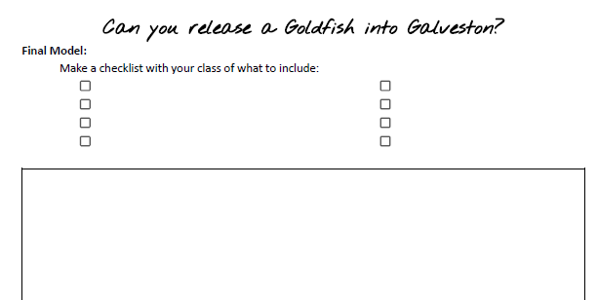
Teachers had students co-create a checklist of what they felt they should include in their final model to show they understood the units’ content
(AST Ch. 12 “Gotta Have Checklist”)

Slide 16
Student Work Samples
Initial vs. Final Models

Slide 17
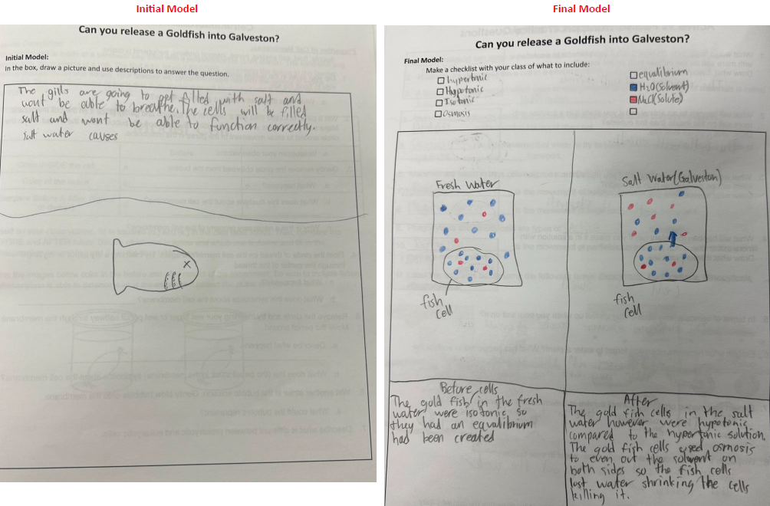

Slide 18
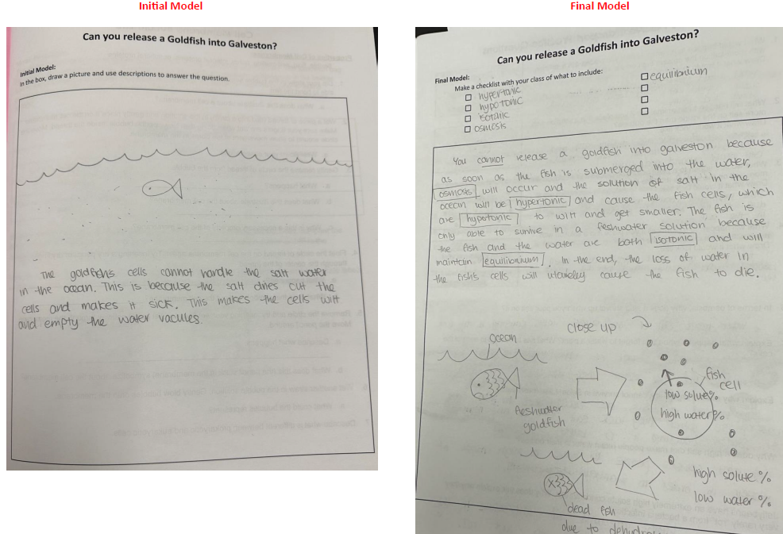

Slide 19
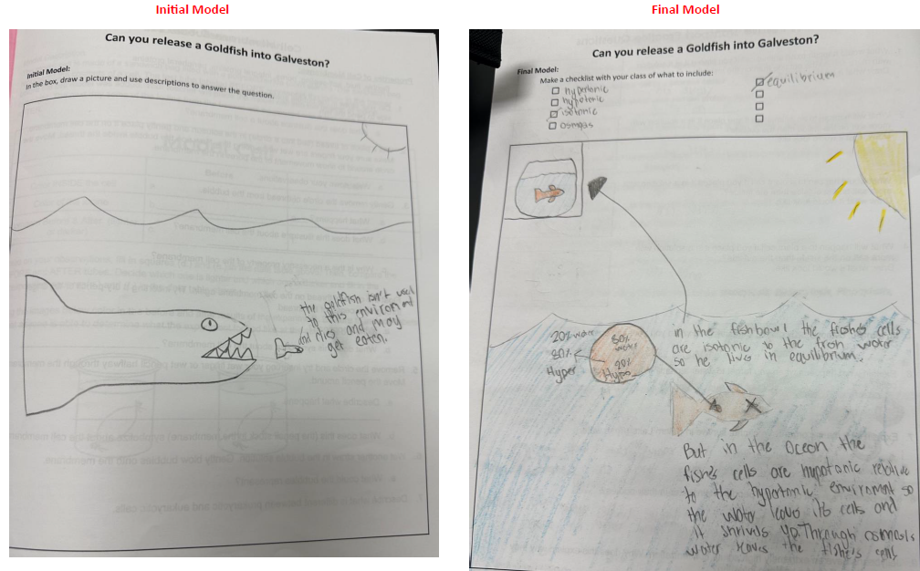

Slide 20
Thoughts and Takeaways from Teachers
“After teaching biology for many years, I start thinking I know how to teach this topic and don’t really like to try new things.
It’s a good thing I teach on a team that’s up for all the "new things". They encourage me to try new things and I know it’s ok for it not to work. However, this worked!”
- seasoned biology teacher

Slide 21
Thoughts and Takeaways from Teachers
Students performed higher on the osmosis test questions this year versus last year.
Students were engaged and curious about the goldfish.
Students would reference back to the goldfish and try to explain it with their new understanding and vocabulary throughout the unit.
Students took more ownership.
This was a great way to for me to see student growth and for students to see their growth.

